Slide 1
Spring Webmvc
Framework Architecture
Group 4
吳崇維 陳熙 林柏劭 王俊翔 蔡昀達
王郁婷 林慶珠 王廷峻 黃柏諭

Slide 2
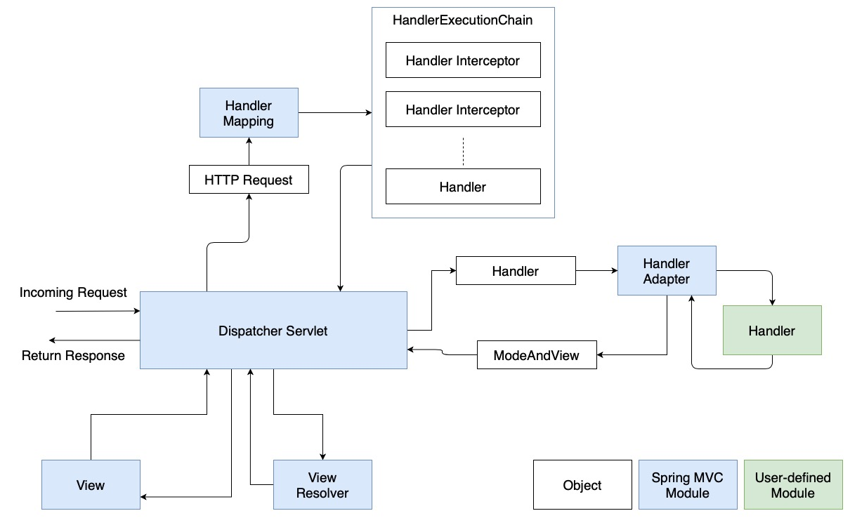
Process Flow
Notes:
Spring mvc 是 request 處理程式，遵從 Front Controller Pattern 設計，以 DispatcherServlet 為統一接收 request 的 controller，將收到的 request 依照定義好的 Mapping 關係呼叫不同 handler 執行對應的動作。

Slide 3
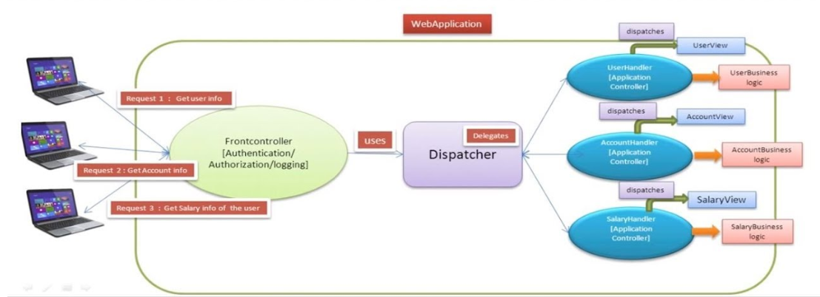
Dispatcher Servlet
Front Controller Pattern

Slide 4
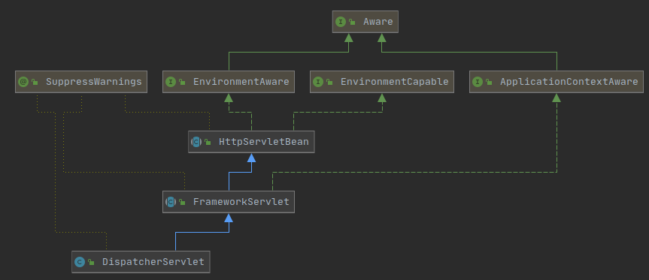
Dispatcher Servlet
Class Diagram

Slide 5
Dispatcher Servlet
Lines of source code: 1455
servlet/DispatcherServlet.java 795
servlet/FrameworkServlet.java 556
servlet/HttpServletBean.java 104

Slide 6
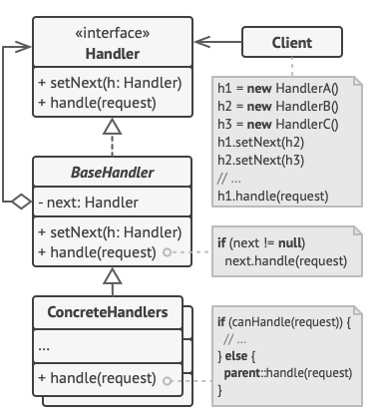
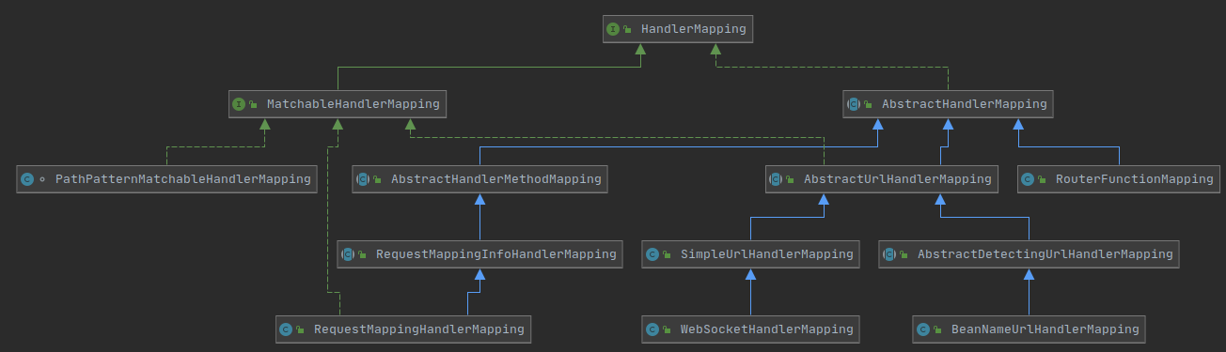
Handler Mapping
Chain of Responsibility Pattern
Funtionality
Map a request to a handler along with a list of interceptors for pre- and post-processing.
Notes:
Chain of responsibility pattern:
注意：design pattern 圖中的 handler 和 handler mapping 是相同的概念 — 處理 reqeust 的 component
不讓 request explicitly specify 使用特定 class 處理，而是讓 request 經由一整串有繼承關係的 class 依序決定是否處理。優點在於如果產生新的 request 必須要處理，只需要 implement handler interface 就可，或是繼承已經存在的 concrete handler。對於 dispatcher servlet 能維持統一的互動介面

Slide 7
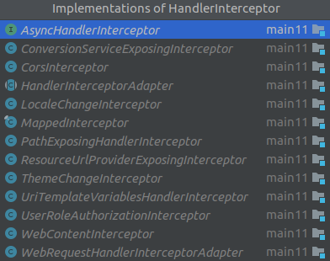
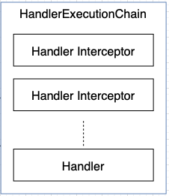
Handler Mapping
Handler Mapping API for Dispatcher Servlet
Handler
not an actual handler
carry the information of a request
Handler Interceptor
useful when you want to apply specific functionality to certain requests
provide flexibility when processing a request
preHandle(...): Before the actual handler is run
postHandle(...): After the handler is run
afterCompletion(...): After the complete request has finished

Slide 8
Handler Mapping - Statistics
Lines of source code: 2746 in total
Handler Mapping (2094 lines)
servlet/handlerMapping.java 20
servlet/handler/MatchableHandlerMapping.java 13
servlet/handler/AbstractHandlerMapping.java 344
servlet/handler/PathPatternMatchableHandlerMapping.java 38
servlet/handler/AbstractDetectingUrlHandlerMapping.java 33
servlet/handler/BeanNameUrlHandlerMapping.java 20
servlet/handler/SimpleUrlHandlerMapping.java 61
servlet/handler/AbstractHandlerMapping.java 344
servlet/handler/AbstractHandlerMethodMapping.java 472
servlet/mvc/method/RequestMappingInfoHandlerMapping.java 347
servlet/mvc/method/annotation/RequestMappingHandlerMapping.java 287
servlet/function/support/RouterFunctionMapping.java 105
# In spring-websocket
socket/server/support/WebSocketHandlerMapping.java 43
Handler Interceptor (549 lines)
servlet/HandlerInterceptor.java 17
servlet/AsyncHandlerInterceptor.java 9
servlet/handler/HandlerInterceptorAdapter.java 6
servlet/handler/WebRequestHandlerInterceptorAdapter.java 41
servlet/handler/UserRoleAuthorizationInterceptor.java 31
servlet/theme/ThemeChangeInterceptor.java 30
servlet/resource/ResourceUrlProviderExposingInterceptor.java 25
servlet/handler/MappedInterceptor.java 133
servlet/i18n/LocaleChangeInterceptor.java 94
servlet/handler/ConversionServiceExposingInterceptor.java 21
servlet/mvc/WebContentInterceptor.java 142
Handler Execution Chain (103 lines)
servlet/handlerExecutionChain.java 103

Slide 9
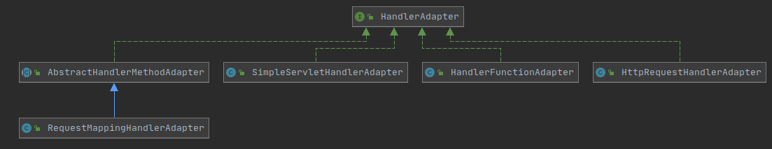
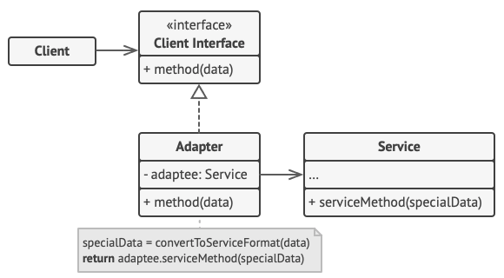
Handler Adapter
Adapter Pattern
Funtionality
Help the DispatcherServlet to invoke a handler mapped to a request, regardless of how the handler is actually invoked.
Notes:
Adapter Pattern:
讓擁有不同 interface 的 object 可以使用對方的功能
1. DispatcherServlet注册HandlerAdapter。DispatcherServlet的 initHandlerAdapters方法,红色标记的部分是关键。由于在配置文件中没有对HandlerAdapter的相关配置，所以 DispatcherServlet获取到的HandlerAdapter是三个默认的HandlerAdapter对象，分别是 HttpRequestHandlerAdapter，SimpleControllerHandlerAdapter和 AnnotationMethodHandlerAdapter，并将这三个对象存入handlerAdapter属性中去。
2. 根据handlerMapping传过来的Handler对象与DispatcherServlet集合属性handlerAdapter中的 HandlerAdapter一一匹配，如果有支持Handler对象的HandlerAdapter，那么HandlerAdapter就会调用自己的 handle方法处理请求。

Slide 10
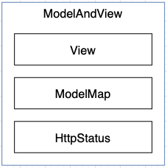
Handler Adapter
Handler Adaptor API for Dispatcher Servlet
Notes:
Adapter Pattern:
讓擁有不同 interface 的 object 可以使用對方的功能

Slide 11
Handler Adapter - Statistics
Lines of source code: 901 in totals
Handler Adapter (777 lines)
servelet/handlerAdapter.java 10
servlet/mvc/method/AbstractHandlerMethodAdapter.java 41
servlet/mvc/method/annotation/RequestMappingHandlerAdapter.java 590
servlet/function/support/HandlerFunctionAdapter.java 60
servlet/mvc/HttpRequestHandlerAdapter.java 27
servlet/mvc/SimpleControllerHandlerAdapter.java 25
servlet/handler/SimpleServletHandlerAdapter.java 24
Model And View (124 lines)
servlet/modelAndView.java 124

Slide 12
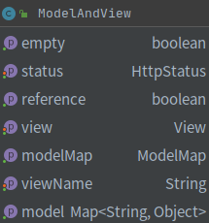
Model And View
Represents a model and view returned by a handler, to be resolved by a DispatcherServlet
The view can take the form of a String view name which will need to be resolved by a ViewResolver object.

Slide 13
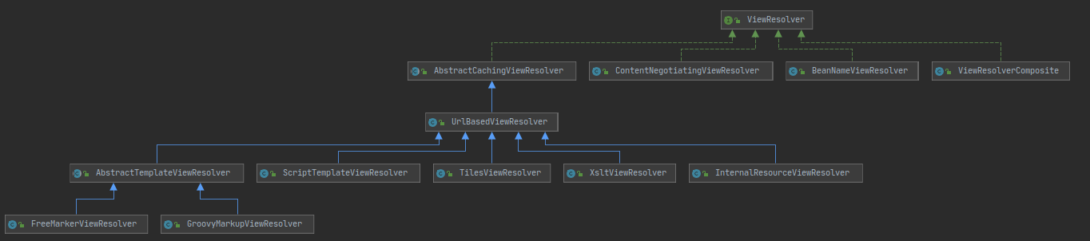
View Resolver
Parse the view name of ModelAndView
Set ViewResolver chain in config
Security
Prevent user from directly access the resources from url
Flexibility
Change the view type with the same dispatcher servlet
Notes:
解析ModelAndView，找出ModelAndView中viewName對應的View並回傳。Servlet會將該model交給View render.
使用哪一個ViewResolver由Dispatcher servlet按照config中的順序選擇，若一個ViewResolver無法成功的回傳View，Dispatcher servlet會繼續往下尋找。
total source code line (without test): 5871(1544)

Slide 14
View Resolver Statistic
 | Code | Comment
XsltViewResolver.java | 67 | 66
XmlViewResolver.java | 84 | 69
ViewResolverComposite.java | 72 | 28
ViewResolver.java | 7 | 45
UrlBasedViewResolver.java | 229 | 322
TilesViewResolver.java | 39 | 40
StandaloneMockMvcBuilder.java | 360 | 157
ScriptTemplateViewResolver.java | 21 | 41
ResourceBundleViewResolver.java | 120 | 140
InternalResourceViewResolver.java | 42 | 60
GroovyMarkupViewResolver.java | 26 | 45
FreeMarkerViewResolver.java | 21 | 49
ContentNegotiatingViewResolver.java | 244 | 89
BeanNameViewResolver.java | 34 | 39
AbstractTemplateViewResolver.java | 37 | 55
AbstractCachingViewResolver.java | 141 | 140
 | 1544 | 1385

Slide 15
View
Set model request and render the content with dispather severlet
Restrict the implementation
The dependency is lower hence it could be done by several people
Notes:
total source code line(without test): 7662(6919)

Slide 16
View Statistic
 | code | Comment
AbstractAtomFeedView.java | 30 | 65
AbstractCachingViewResolver.java | 141 | 140
AbstractFeedView.java | 33 | 57
AbstractJackson2View.java | 130 | 96
AbstractPdfStamperView.java | 36 | 69
AbstractPdfView.java | 50 | 117
AbstractRssFeedView.java | 26 | 54
AbstractTemplateView.java | 98 | 81
AbstractUrlBasedView.java | 36 | 49
AbstractView.java | 206 | 237
AbstractXlsView.java | 37 | 60
AbstractXlsxStreamingView.java | 18 | 33
AbstractXlsxView.java | 14 | 33
ContentNegotiatingViewResolver.java | 244 | 89
FreeMarkerView.java | 198 | 194
GroovyMarkupView.java | 74 | 51
InternalResourceView.java | 81 | 139
MappingJackson2JsonView.java | 67 | 87
MappingJackson2XmlView.java | 48 | 44
MarshallingView.java | 83 | 67
RedirectView.java | 345 | 272
ScriptTemplateView.java | 341 | 78
SmartView.java | 4 | 25
TilesView.java | 90 | 48
View.java | 16 | 72
XsltView.java | 257 | 200
 | 2703 | 2457

Slide 17
Others?

Slide 18
Locales
AbstractLocaleContextResolver.java 28
AbstractLocaleResolver.java 15
AcceptHeaderLocaleResolver.java 74
CookieLocaleResolver.java 171
FixedLocaleResolver.java 47
LocaleContextResolver.java 11
LocaleResolver.java 9
SessionLocaleResolver.java 76
total 431

Slide 19
Themes
AbstractThemeResolver.java 12
CookieThemeResolver.java 60
FixedThemeResolver.java 15
SessionThemeResolver.java 20
ThemeResolver.java 8
total: 115

Slide 20
Other Unclassified Modules and Code
ExceptionResolver
ContextResolver
FlashMap, FlashMapManager
LocaleResolver, LocaleContextResolver
ThemeResolver
SmartView
Controller
mvc/condition
handlerMethod
各種 annotation
config/
resource/
support/
tags/
theme/

